Slide 1


BE Project Presentation On “Commodity Stock Recommendations and Price Prediction using Prescriptive Analytics Techniques ”
Smt. Kashibai Navale College of Engineering,Pune
Presented By
Harish Hatmode B150364322 Guided By
Pragati Bankar B150364239 Dr. K. N. Honwadkar
Vishal Wankhede B150364552
Onkar Kulkarni B150364375

Slide 2
Outline
Motivation
Introduction
Problem Statement
State of the Art
State of the Art Evaluation
System Architecture
Proposed Algorithm
System Diagrams
Mathematical Model
System Requirements
Results
Advantages and Limitations
Conclusions and Future work.
List of publications
References

Slide 3
Motivation
Historic price data.
Fluctuations in commodity prices affect the global economic activity.
Commodity price movements have a major impact on overall performance.
Spot prices and future prices are non-stationary they form a co-integrating relation.
For efficient manufacturing the actual real-time consumption is necessary.
Use in agricultural field.
12-06-2021
BE Project SKNCOE 2020-21
3

Slide 4
Introduction
Popularity of Commodity price forecasting.
Business Intelligence is very effective to implement forecasting commodity prices and stock modelling.
Many methods are used to predict the price in the market but none of these methods acceptable consistent for prediction.
Attempts to use Business Intelligence technique in this project.
12-06-2021
BE Project SKNCOE 2020-21
4

Slide 5
Problem Statement
Build a system that can predict commodity prices and stocks so that farmers can easily take appropriate decisions regarding their agricultural produce.
12-06-2021
BE Project SKNCOE 2020-21
5

Slide 6
State of the Art
Author | Paper Name | Year | Description
S. Shrivastava, S. N. Pal, and R. Walia | Market Intelligence for Agricultural Commodities Using Forecasting and Deep Learning Techniques | 2019 | Use of Market Intelligence. For commodity price predictions, they used ARIMA and RNN techniques.
Mann A. K., and Kaur N. | Review paper on clustering techniques | 2013 | Supervised and Unsupervised learning techniques were used to extract useful information from bulky data set in reasonable format.
12-06-2021
BE Project SKNCOE 2019-20
6

Slide 7
Author | Paper Name | Year | Description
Shah N., Solanki M., Tambe A., and Dhangar D | Sales Prediction Using Effective Mining Techniques | 2015 | Discussed about effective business decision-making that can be done using appropriate sales prediction techniques
S. Cheriyan, S. Ibrahim, S. Mohanan, S. Treesa | Intelligent Sales Prediction Using Machine Learning Techniques | 2018 | Various data mining techniques like Generalized Linear Model (GLM), Decision Tree (DT) and Gradient Boost Tree (GBT) were used for price prediction.

Slide 8
State of the Art Evaluation
Paper Name | Method Used | Accuracy/Result | Issues
Market Intelligence for Agricultural Commodities Using Forecasting and Deep Learning Techniques | ARIMA and RNN | Good | Depends upon several environmental and economic factors
Review paper on clustering techniques | Partition-based algorithms, hierarchical-based algorithms, density-based algorithms and grid-based algorithms. | Good | Limited data set is used
12-06-2021
BE Project SKNCOE 2019-20
8

Slide 9
Paper Name | Method Used | Accuracy/Result | Issues
Sales Prediction Using Effective Mining Techniques | Apriori algorithm | Modification makes algorithm more efficient | Performance and efficiency can be improved.
Intelligent Sales Prediction Using Machine Learning Techniques | Generalized Linear Model (GLM), Decision Tree (DT) and Gradient Boost Tree (GBT) | Gradient Boost having 98% Accuracy, Decision Tree Having 71% accuracy and Generalized linear Model having 64% accuracy | Fields and attributes, used in analysis were insufficient

Slide 10
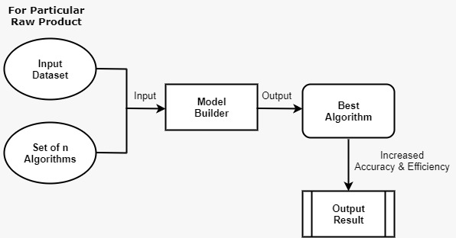
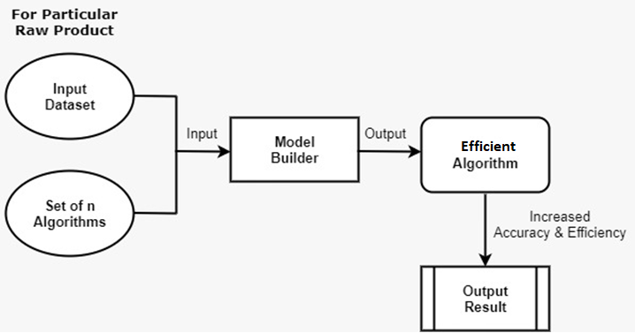
System Architecture

Slide 11
Proposed Algorithms
Our proposed model takes set of algorithms such as Decision Trees, K Nearest Neighbor, Gradient Boost etc.
The Model Builder will take input of dataset and set of algorithms.
The algorithm which have more accurate result considered as Efficient Algorithm.
Using this efficient algorithm, commodity price and stock values are predicted.

Slide 12
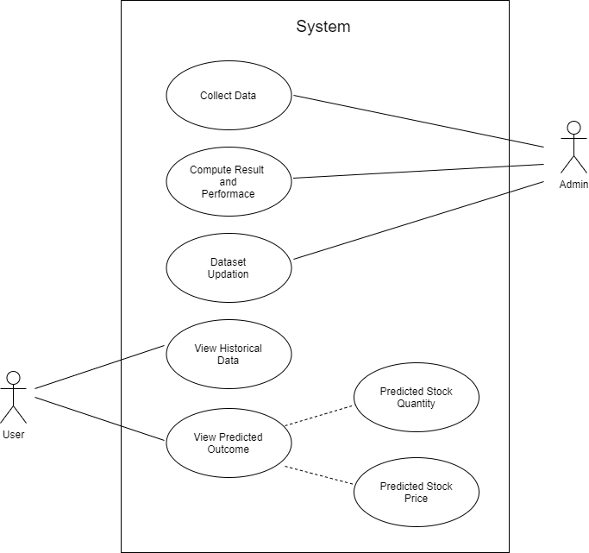
Use Case Diagram

Slide 13
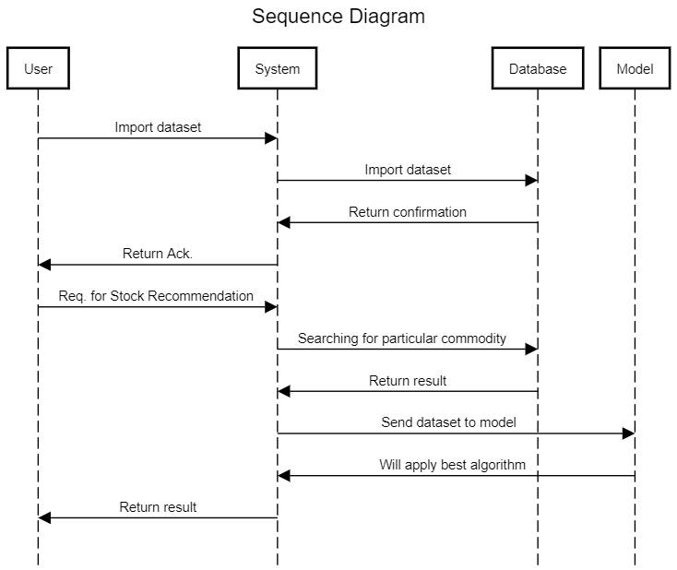
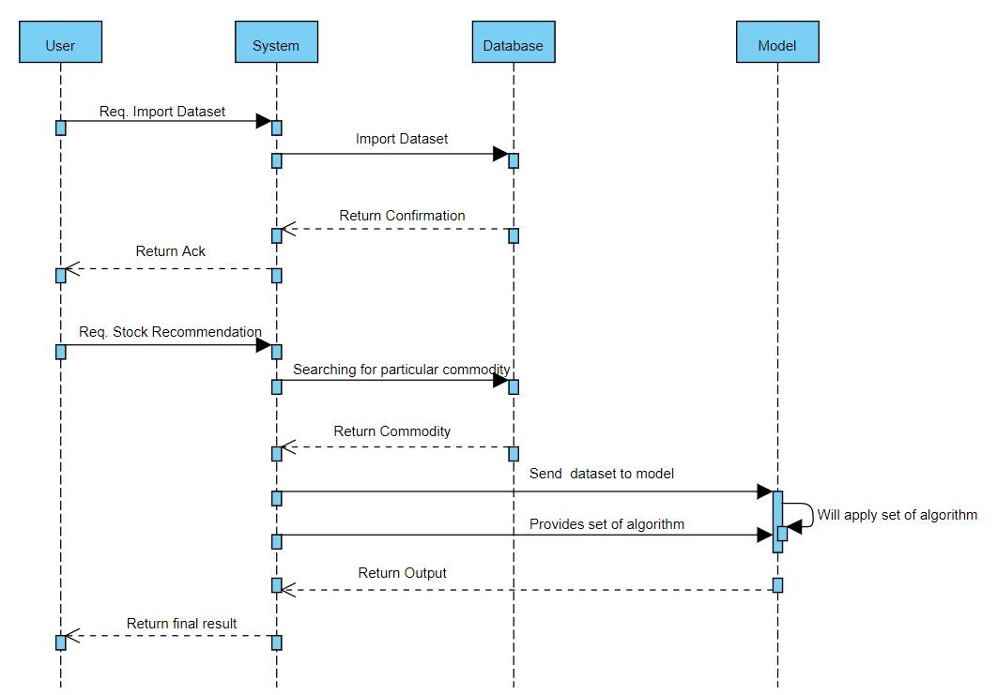

Slide 14
System Requirements
SOFTWARE REQUIREMENTS
Python 3, PyCharm, Visual Studio
This system requires python libraries as follows:
Sklearn
Tkinter
Seaborn
Xgboost
Numpy, Pandas, Matplotlib
HARDWARE REQUIREMENTS
4 GB RAM or more
Intel processor core i5 5th gen or more.
12-06-2021
BE Project SKNCOE 2019-20
14

Slide 15
Advantages & Limitations
ADVANTAGES
Performance evaluation
Accuracy and Reliability
To achieve effectiveness
Smart and wise investment
LIMITATIONS
Volatile investment
Require daily price data for each commodity
A large volume of data requires a system with high configurations
12-06-2021
BE Project SKNCOE 2019-20
15

Slide 16
Conclusion
As per research Business Intelligence plays a very important role in "Commodity stock and price prediction".
If we apply same algorithm for all the products then the accuracy of prediction fluctuates.
Comparison between algorithms gives efficient algorithm for that commodity.
Different efficient algorithm for different commodity.
Accuracy in predictions increases.
12-06-2021
BE Project SKNCOE 2019-20
16

Slide 17
Future Scope
In the future, the accuracy of this system can be further improved by utilizing a much bigger dataset than the one being utilized currently.
In the future work, we will try to apply this model to other different stocks commodity, and try to combine different algorithms to build a more accurate prediction model.
We can implement crop selection based on future prices
12-06-2021
BE Project SKNCOE 2019-20
17

Slide 18
List of Publications
http://www.icinc.org/
Journal Name: Journal of Communications
Commodity Stock Recommendation and Price Prediction using Prescriptive Analytics Techniques
Status - Submitted

Slide 19
References
S. Shrivastava, S. N. Pal, and R. Walia, “Market Intelligence for Agricultural Commodities Using Forecasting and Deep Learning Techniques,” Springer Nature Switzerland, 2019.
Mann A. K., and Kaur N., “Review paper on clustering techniques,” Global Journal of Computer Science and Technology, 2013.
Shah N., Solanki M., Tambe A., and Dhangar D, “Sales Prediction Using Effective Mining Techniques,” International Journal of Computer Science and Information Technologies, Vol. 6 (3), 2015.
S. Cheriyan, S. Ibrahim, S. Mohanan, S. Treesa, “Intelligent Sales Prediction Using Machine Learning Techniques,” IEEE, 2018.
12-06-2021
BE Project SKNCOE 2019-20
19

